Slide 1

Warmest Regards from Golam Md. Muradul Bashir
Institute of Information and Communication Technology (IICT)
Bangladesh University of Engineering and Technology (BUET)
Dhaka 1000, Bangladesh

Slide 2
CCE 411 | Algorithm Engineering | 3.00
Course Content | Computational complexity, Parameterized complexity, Algorithms for combinatorial optimization, practical computing and heuristics, Approximation algorithms, LP based approximation algorithms, randomized algorithms, Experimental algorithmic, Algorithms in state-of-the-art fields like Bioinformatics, Grid Computing, VLSI design etc.

Slide 3
Reference Books | 1. Thomas H. Cormen: Introduction to Algorithms 2. Ellis Horowitz & Sartaj Sahni : Fundamentals of Computer Algorithms

Slide 4
In computer science, the computational complexity, or simply complexity of an algorithm is the amount of resources required for running it (a property unrelated to “complexity” in a conventional sense).

Slide 5
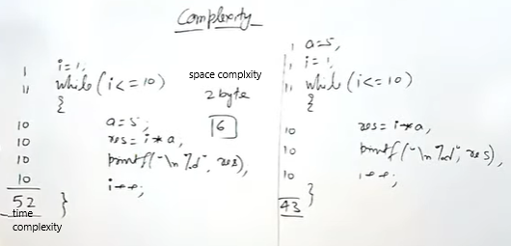
Computational Complexity

Slide 6
https://www.youtube.com/watch?v=M0ELyuRgmdE&list=RDCMUCtpbGVEPIgRJ934DYasSRWQ&start_radio=1

Slide 7
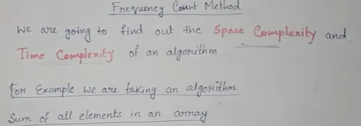
How To Calculate Time And Space Complexity From An Algorithm...Frequency Count Method Explain

Slide 8
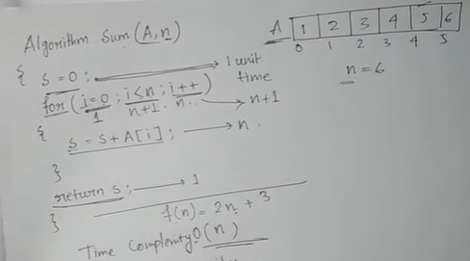
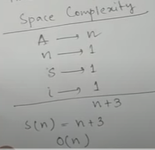
How To Calculate Time And Space Complexity From An Algorithm...Frequency Count Method Explain

Slide 9
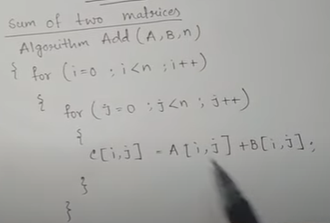
Another Example

Slide 10
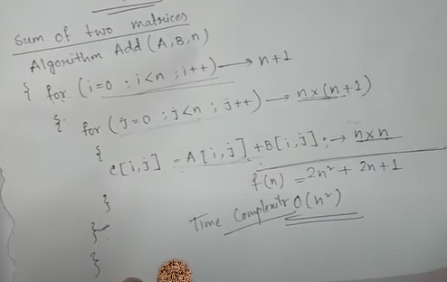
Another Example

Slide 11
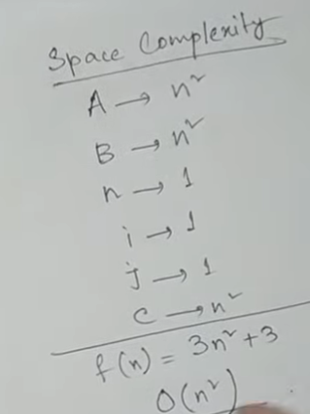
Another Example

Slide 12
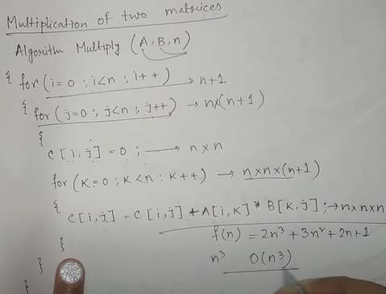
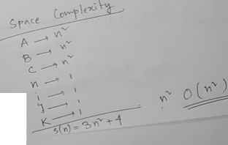
Another Example-2

Slide 13
https://www.youtube.com/watch?v=To1LR-Bz-Iw

Slide 14
computational complexity
1. What is Complexity.
2. What is Space Complexity.
3. What is Time Complexity.
4. What are Time and Space Complexity.
5. How to calculate complexity.
6. How to find time complexity.
7. How to find space complexity.

Slide 15
computational complexity
https://www.youtube.com/watch?v=M0ELyuRgmdE

